Slide 1

Micro Skill
Skill of Using Blackboard

Slide 2
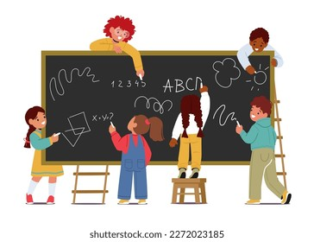
Skill of Using Blackboard
It involves writing legible on the blackboard, neatness in the blackboard work and appropriateness of written work on the blackboard.

Slide 3
Components of the Skill of Using Blackboard
Legibility of Handwriting
Neatness in Blackboard Work
Appropriateness of Written Work on the Blackboard

Slide 4
Legibility of Handwriting
Distinct difference between letters
Spacing Between Letters and Words
Slantness of each letter

Slide 5
Legibility of Handwriting
Size of the letter
Size of the Capital Letters & Small letter
Thickness of the lines

Slide 6
Neatness in Blackboard Work
Straightness of the lines
Spacing between the lines
Avoidance of overwriting
Focusing the relevant matter

Slide 7
Appropriateness of Written Work on the Blackboard
Continuity in the Points
Brevity and Simplicity
Drawing attention & focusing

Slide 8

Remember
Write only silent points one after another as they are being developed.
The points written on the blackboard should have continuity.
Blackboard summary should be brief & simple

Slide 9
Underline only those points to which you want to draw the pupils’ attention.
Illustration & diagrams should be simple, large and clear.
Avoid unnecessary details.

Slide 10
Take care for effective use of Blackboard
Check the condition of the black board for its usability.
Check the position of light.
Blackboard is clean before & after use.
Keep required amounts of chalks (both coloured & white)
Use pointer/scale for explaining the points.
Stand one side of the blackboard.

Slide 11
Avoid noise of the chalk while writing.
Clean the matter from the black board in downward and upward strokes.
Never use fingers for erasing.
Avoid committing mistakes in the content while writing on the blackboard.

Slide 12

Thank you
Dr. Ranu Varshney

